Slide 1
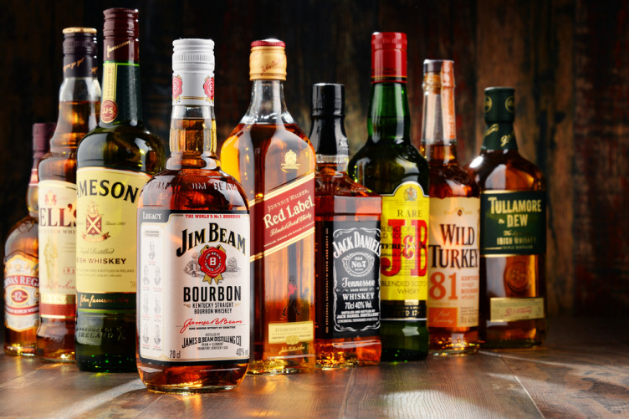
Alcohol Consumption -the increase in alcohol consumption with respect to the increase in tax and an increase in unemployment per year.

Slide 2
Made by:
Tech fanatics
R.Vaishnavi
Samreen Sultana
Chitla Venkata Trinadh
Anusha Narayan
THANKYOU

Slide 3
1.1 Introduction:
*Python:
Python is one of the most widely used high level programming language .
It was initially designed by Guido Van Rossum in 1991 and later developed by
Python Software Foundation.
Some of the reasons for using this as high level programming language is
-open source
-easy to learn
-exception handling
*Machine Learning:
It is an application of artificial intelligence (AI) that provides systems the ability to automatically learn and improve from experience without being explicitly programmed.
It consists of two models that is regression and classification.

Slide 4
1.2 Objective Of Research
The Objective of research project summarizes
the consumption of AlcoholConsumption.

Slide 5
1.3 Problem Statement
The dataset consists of several parameters out of which we need to predict whether which parameter affects the Alcohol consumption and in this project by doing Multi Variable Linear regression we will predict the consumption of alcohol with respect to tax collection and unemployment.

Slide 6
2.Review of Literature
According to the 2003 World Health Survey (total sample size n = 9540, males n = 4605 and females n = 4935; sample population aged 18 years and above), the rate of heavy and hazardous drinking among the total population was 1.4% (total), 2.4% (males) and 0.4% (females). Heavy and hazardous drinking was defined as average consumption of 40 g or more of pure alcohol a day for men and 20 g or more of pure alcohol a day for women.
National Family Health Survey (NFHS-3, 2005-06)* The third National Family HealthSurvey (NFHS -3) conducted in 2005-06 found that only 2% of women drink alcoholwhereas it indicates that around one third o f men drink alcohol between the age group 15-49 in India.
The recent couple of decades have focused on alcohol as a public health problem, and there is research evidence of harmful drinking practices in the community and its association with mental health (Patel, 2007), sexual violence, seizures and neurological dysfunction, association with communicable diseases like HIV and tuberculosis, as well as non-communicable diseases like hypertension and diabete.

Slide 7
Alcohol Consumption w.r.t unemployment:
-India's annual alcohol intake increased by 38 per cent.
-Intake is growing in low- and middle-income countries, while the total volume of alcohol consumed in high-income countries has remained stable.
-Very excessive drinking is related to number of job-losses, broken partnerships, living alone and duration of unemployment.
-The estimates suggest that by 2030 half of all adults will drink alcohol, and almost a quarter (23 per cent) will binge drink at least once a month, researchers said.
-Alcohol is a major risk factor for disease, and is causally linked to over 200 diseases, in particular, non-communicable diseases and injuries.

Slide 8
Alcohol Consumption w.r.t Tax-Collection:
According to statistics, Alcohol sector is the second largest contributor of taxes to state Government exchequers yielding more than 90, 000 crores in taxes every year. The total tax impact for liquor companies are in the range from 70-150% in most states as no inter-tax set-offs are available for them.
While alcoholic beverages represent 25% of the food and beverage market in China and the US, in India, spirits alone is 34%, making it the largest category. On most states, alcohol contributes to 20 to 25% of state revenue (state excise).

Slide 9
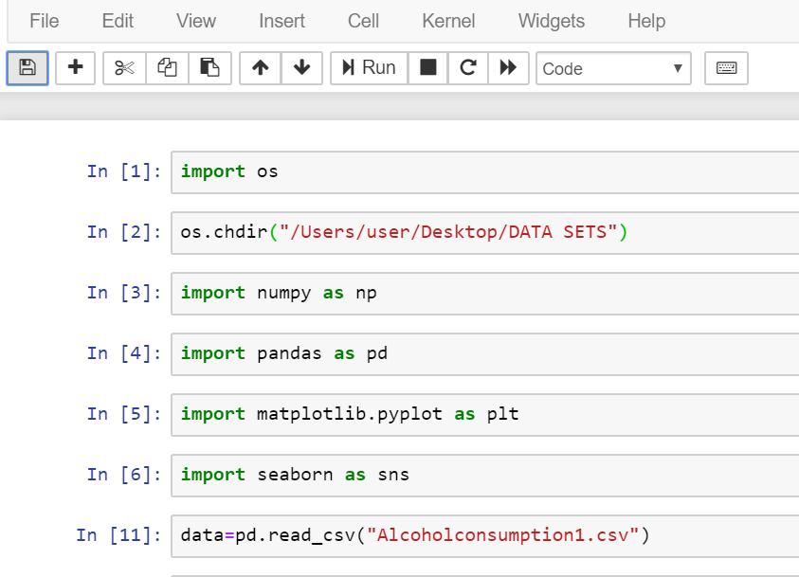

Slide 10
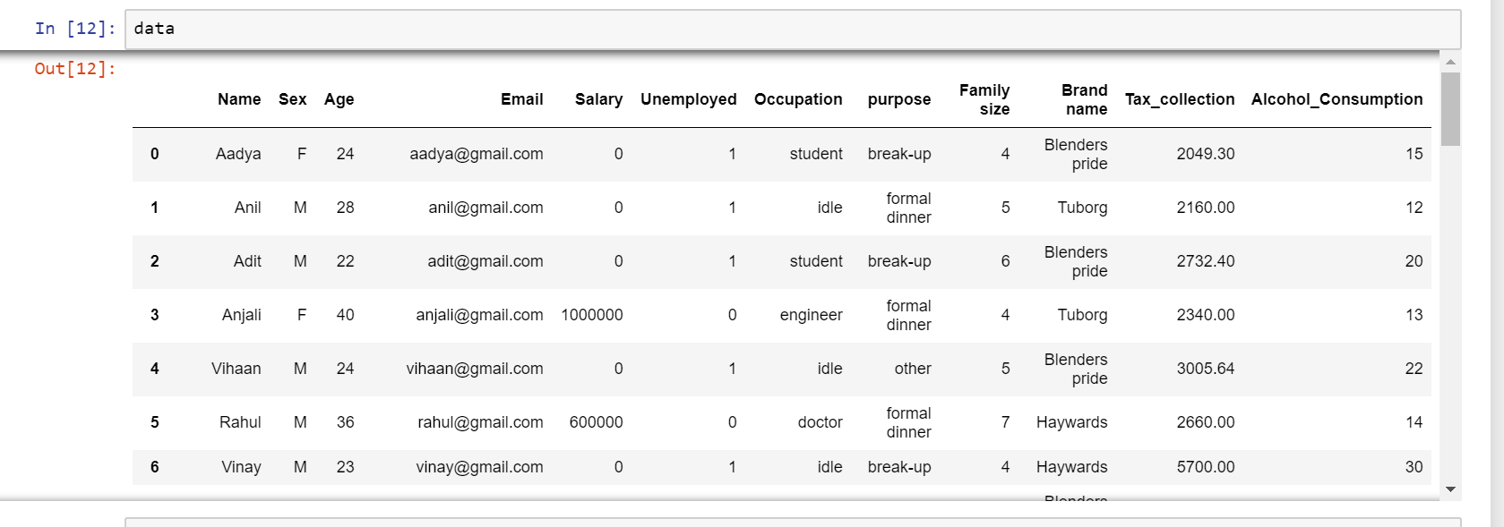

Slide 11
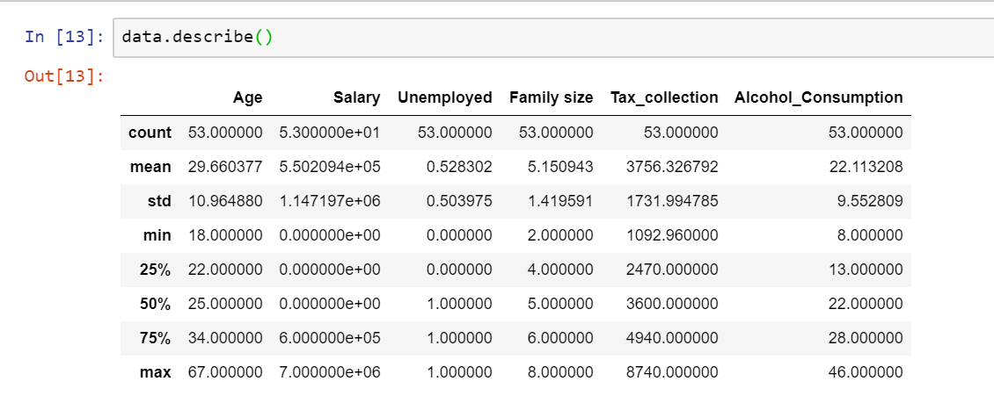

Slide 12
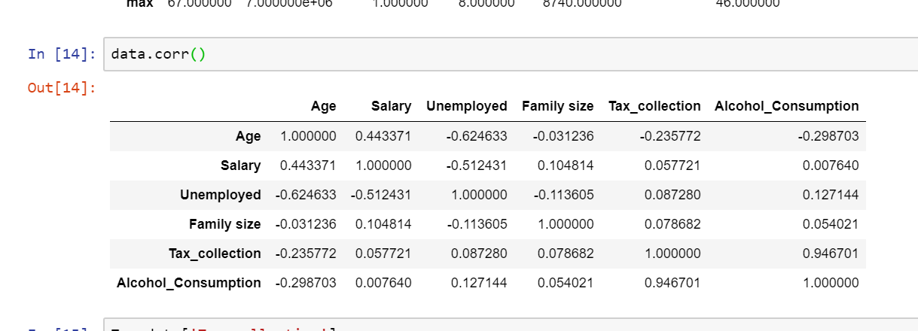

Slide 13
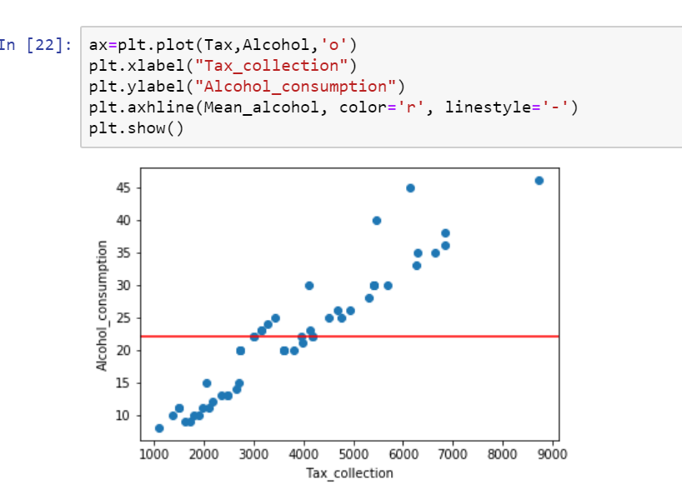

Slide 14
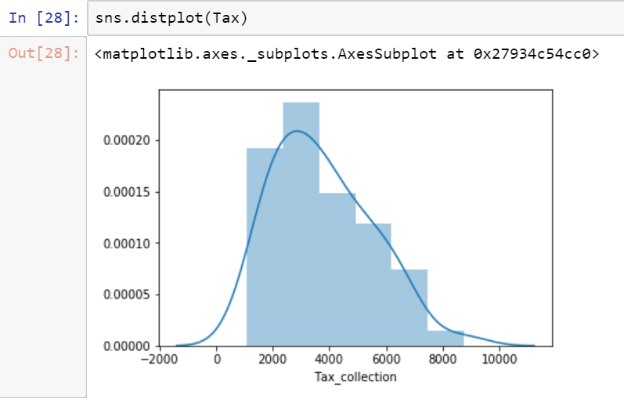

Slide 15
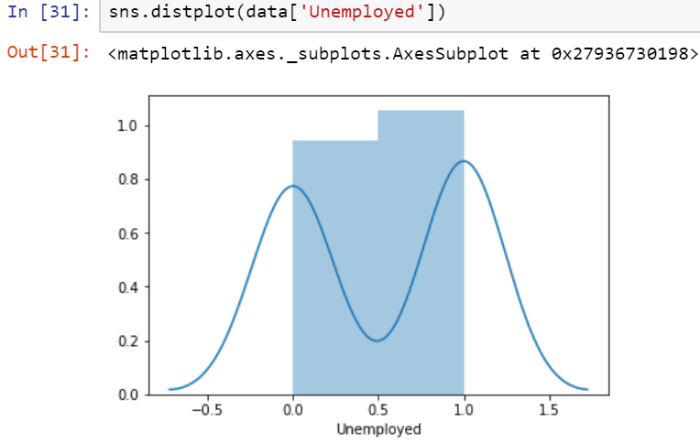

Slide 16
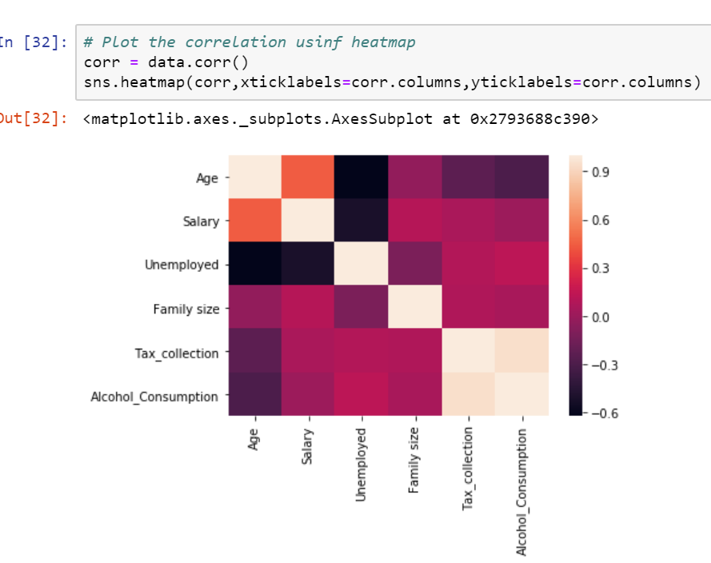

Slide 17
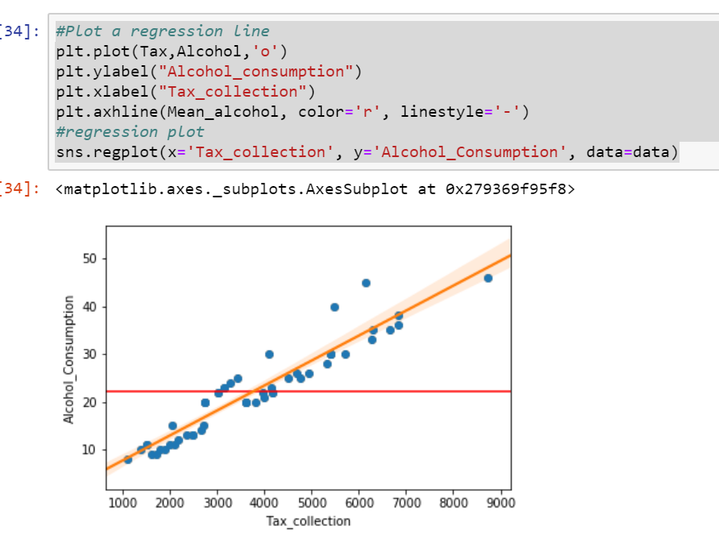

Slide 18
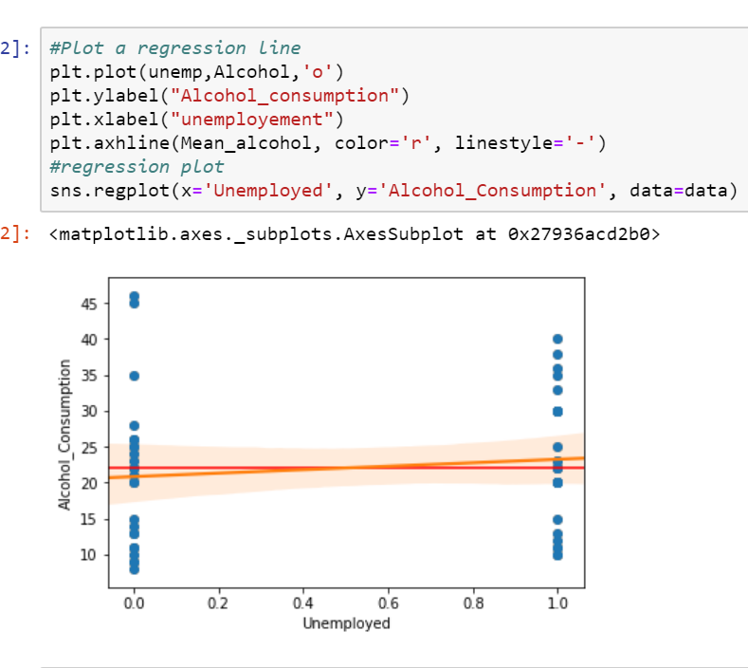

Slide 19
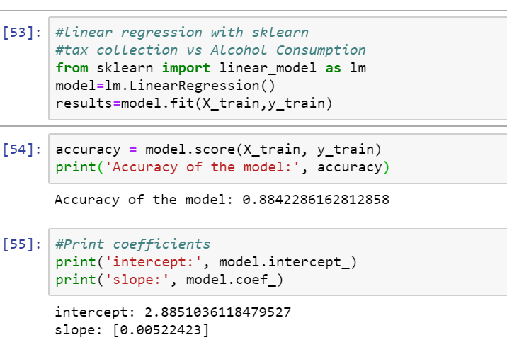

Slide 20
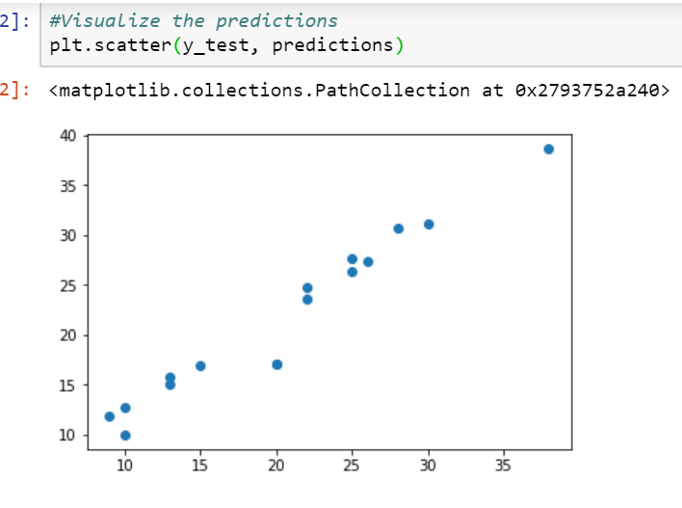

Slide 21
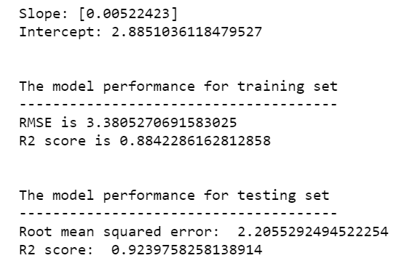

Slide 22
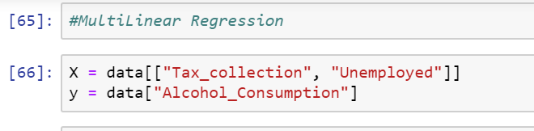

Slide 23
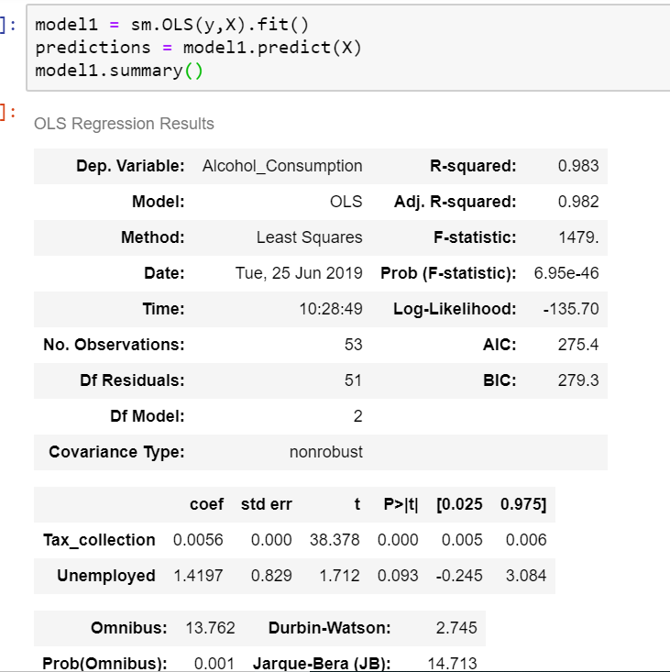

Slide 24
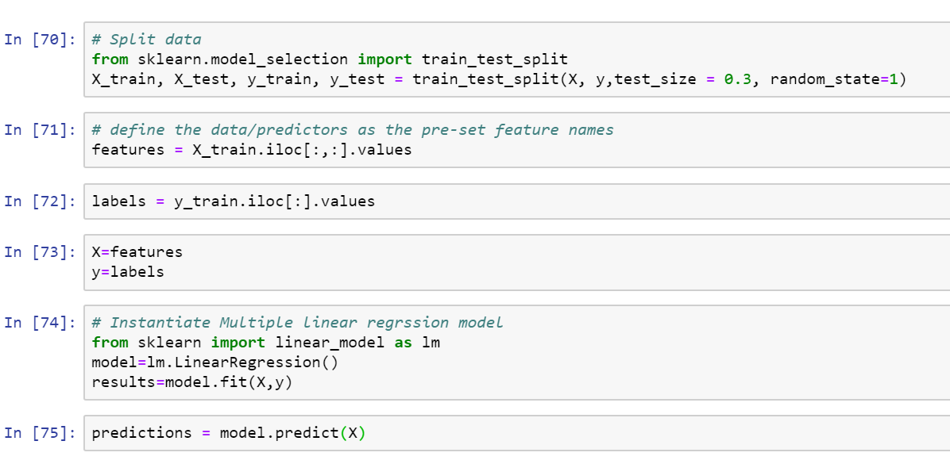

Slide 25
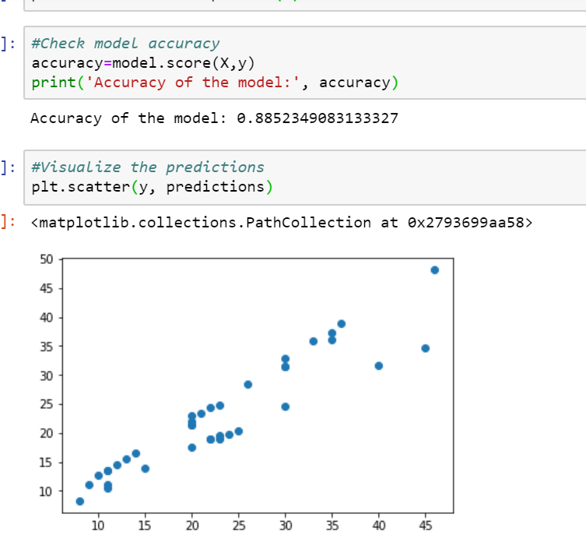

Slide 26
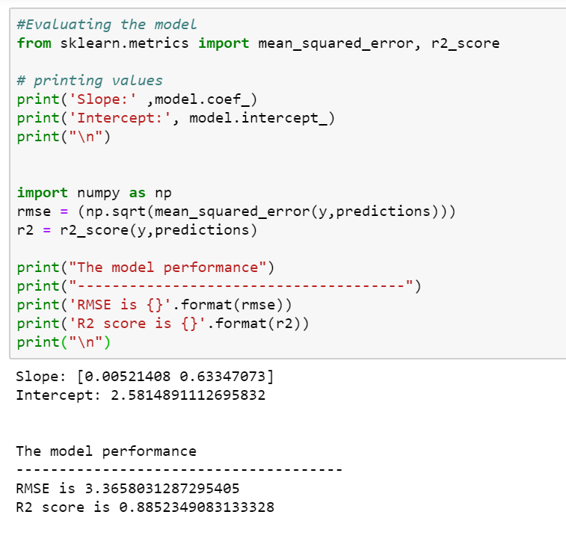

Slide 27
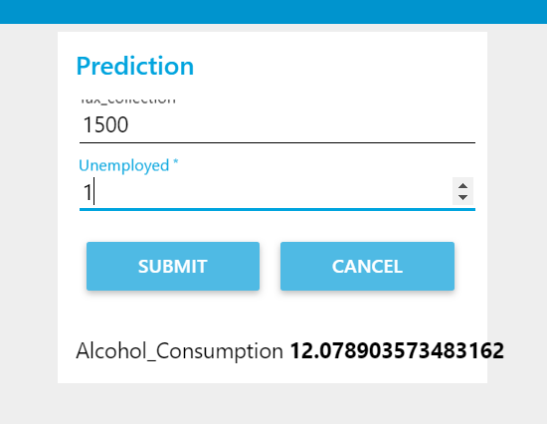

Slide 28
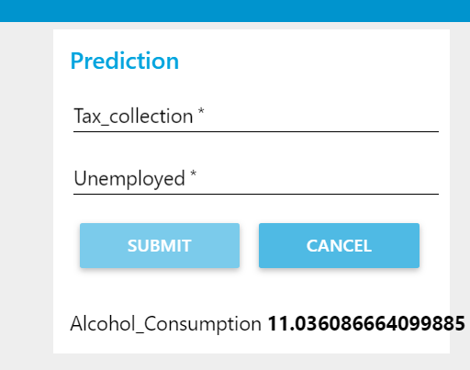

Slide 29
Findings and Suggestions:
-> In this dataset we have unemployment and tax collection as features and alcohol consumption as target or response variable.
->The future updations can be made on the prediction based on varying input\output.
->The R-Squared value of this model is 89% which predicts that accuracy of the model is high.
->We have seen that alcohol consumption depends on the purpose variable too..It may vary depending on the data collection.
->Alcohol consumption is seen more in unemployed citizens. It might even vary for employed people due to work stress (or) unable to fulfill the requirements of family members.
->34% of tax is collected on alcohol beverages and we predicted that it is also affecting the alcohol consumption.

Slide 30
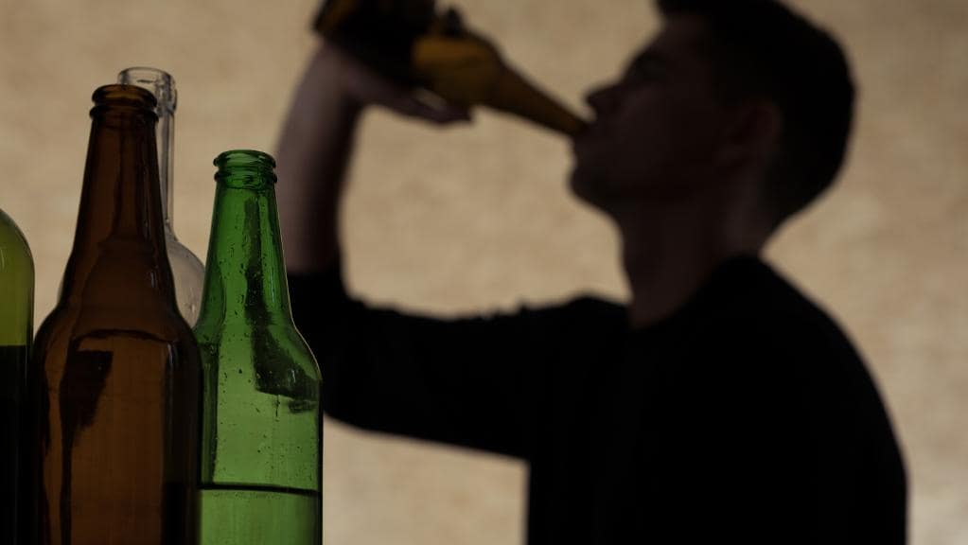
6.Conclusion:
-Based on this model we can predict that unemployment and tax collection affects the alcohol consumption.

